Slide 1

Wine Review Classification
Lauren Busalacchi
Regis University

Slide 2
Table of Contents
The problem
What is LSA?
Practical Application of LSA
Results of the LSA

Slide 3
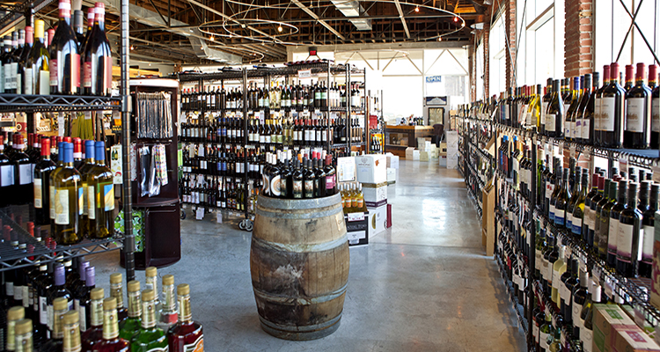
The Problem
What’s something new I’ll like?!
https://www.visitkc.com/visitors/things-do/shopping/kansas-citys-top-wine-shops

Slide 4
What is Latent Semantic Analysis?
Natural Language Processing & Topic Modeling
Takes a lot of different words at once, and provides a potential framework for understanding what they mean.
Computers can’t just do this for us!

Slide 5
What is Latent Semantic Analysis?
“I like dogs.”
“I do not like dogs, but I love cats.”
“I watch a lot tv.”
“Those dogs are so fluffy!”
Dogs – 3
Like – 2
Love – 1
TV – 1
Fluffy – 1
Etc…
Topic 1 – Dogs
Topic 2 – Like
Topic 3 – Love, TV, Fluffy

Slide 6
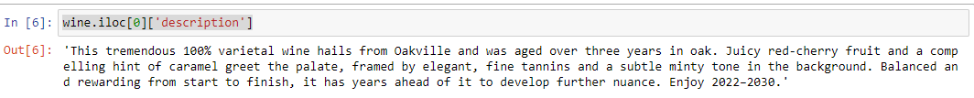
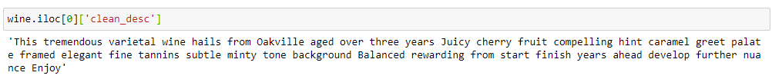
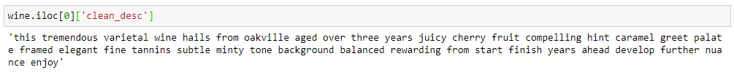
Practical Application
“Cleaning” the relevant text:
.,!@#%&()?/0123456789
Three letter words
Capital Letters
Custom Stopwords

Slide 7
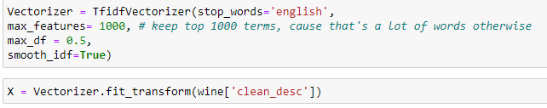
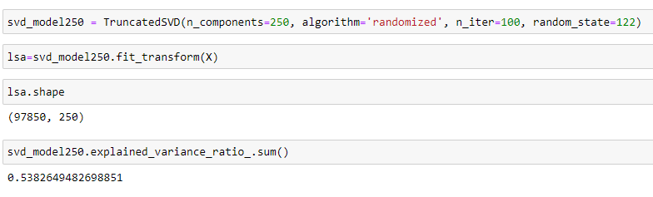
Practical Application
Vectorize:
Model:

Slide 8
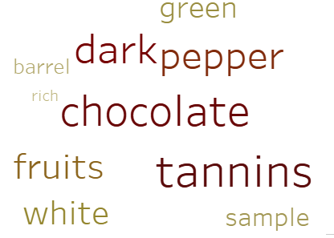
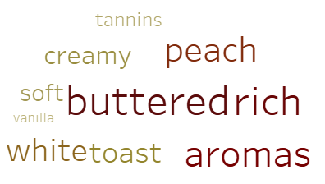
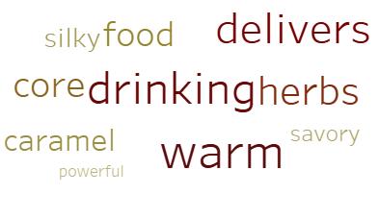
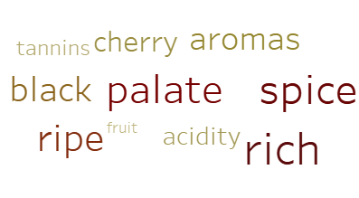
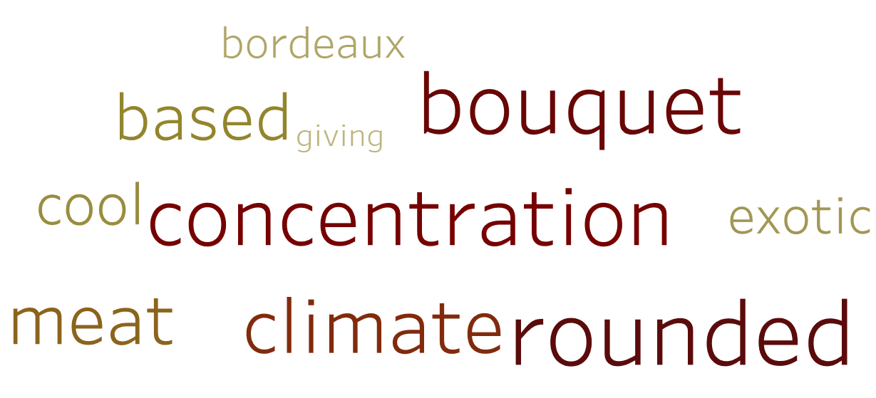
Results

Slide 9
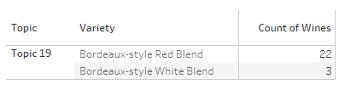
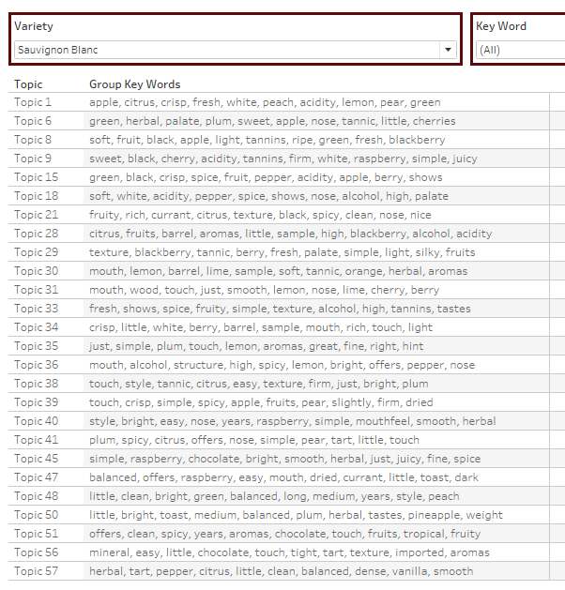
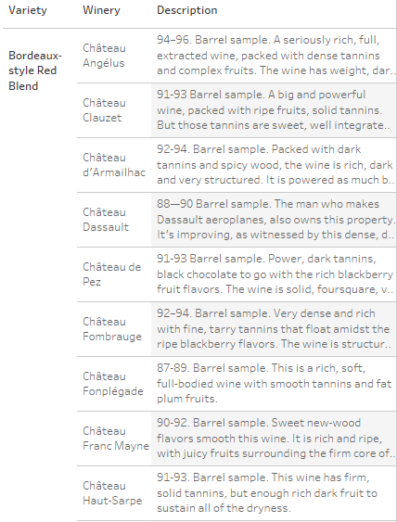
Results

Slide 10
Future Enhancements
Add to customized stopwords list
Lemmatization
Optimize to create less words and less topics
Reduce data input size

Slide 11
Thank You!
See more details at https://github.com/LBusalacchi/msds696

